Slide 1
Finding difference in images
Thuy Nguyen, Abdulaziz Ismail, Ronalds Upenieks

Slide 2
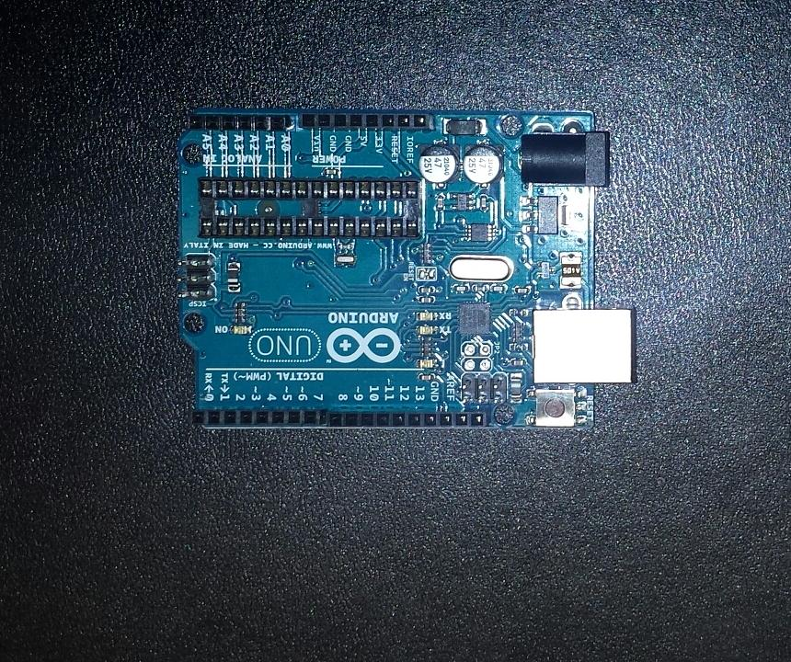
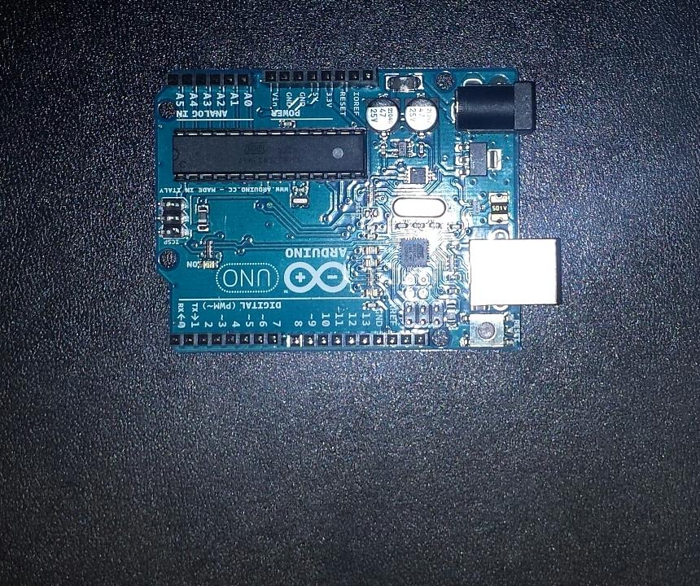
Objective: detect difference between 2 given images

Slide 3
Challenges faced
Flash
Different angle / perspective
Background: mix of differently coloured pixels
Lighting

Slide 4
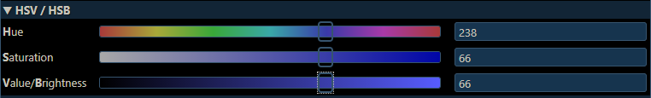
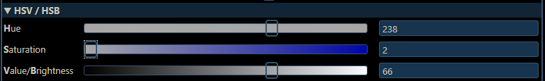
HSV
Hue, Saturation, Value (Brightness)

Slide 5
Uses of hsv: Flash
No Flash
Flash
Solution: Ignore blue pixels whose Value (Brightness) parameter exceeds threshold

Slide 6
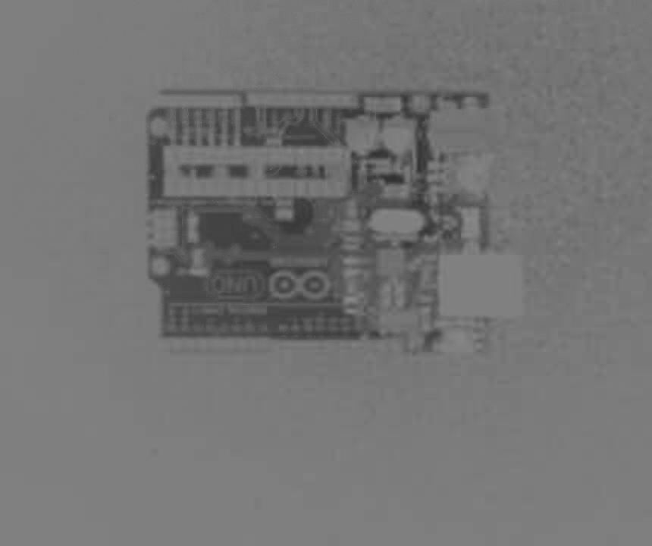
Background extraction
1. Extract Y of YUV

Slide 7
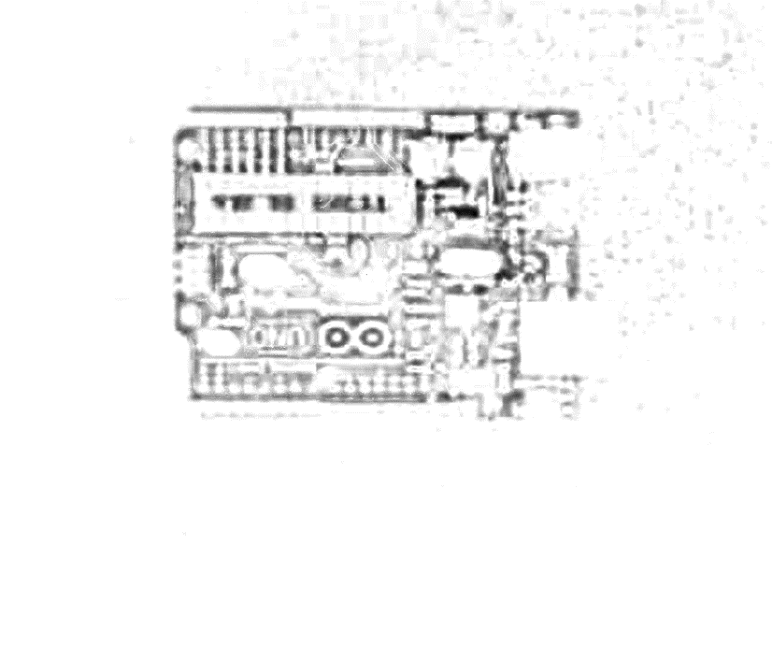
Background extraction

Slide 8
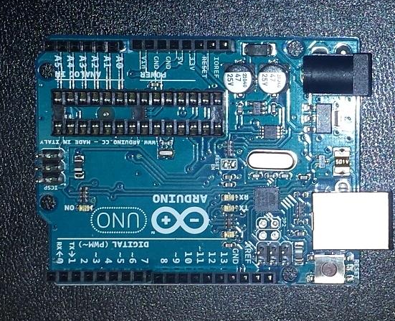
Crop ROI based on coordinates

Slide 9
Detecting differences
(x: 50, y: 200)
Pixel to pixel comparison impossible
Object has different coordinates between 2 images

Slide 10
Detecting differences
Region 1: Grey: 200
Pink: 400
Region 2: Grey: 100
Pink: 500
Compare regions on images based on pixel occurrence.
Difference of 50% in Grey and 25% in Pink.
On a threshold of 90%, no difference is detected.

Slide 11
Detecting differences
Region 1: Grey: 100
Blue: 500
Region 2: Grey: 100
Blue: 500
Green: 300
Grey difference 0%,
Blue difference 60%
Green difference 100% - Surpassed threshold

Slide 12
Detecting differences
Region 1: Grey: 100
Blue: 500
Region 2: Grey: 100
Blue: 500
Green: 300
Grey difference 0%,
Blue difference 60%
Green difference 100% - Surpassed threshold

Slide 13
Detecting differences
Region 1: Grey: 200
Yellow: 400
Region 2: Grey: 100
Yellow: 500
Orange: 2
Grey difference 50%
Yellow difference 20%
Orange difference 100% - Surpassed threshold but minimum # of occurrences not satisfied.

Slide 14
Detecting differences
Region 1: Grey: 200
Yellow: 400
Region 2: Grey: 100
Yellow: 500
Orange: 2
Difference highlighted in original image
Locational coordinates kept track of via crop coordinates

Slide 15


original images

Slide 16
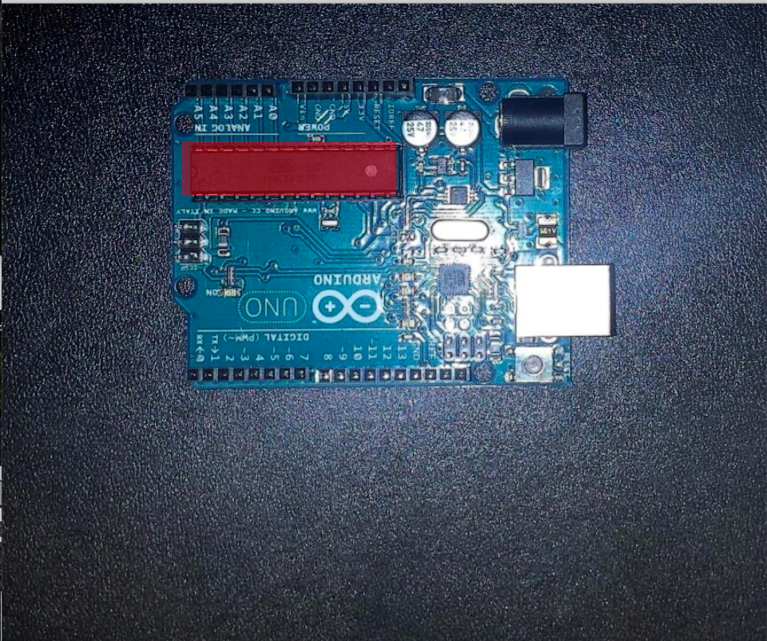
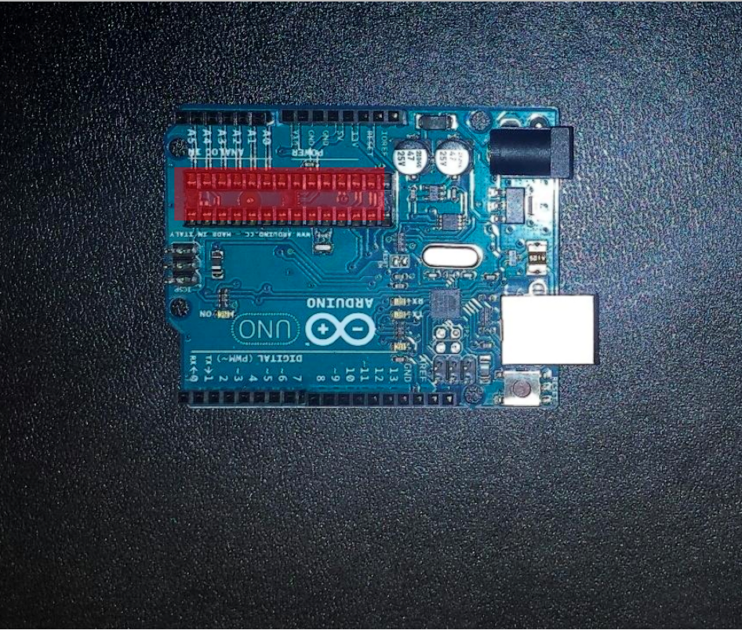
Results: original images

Slide 17
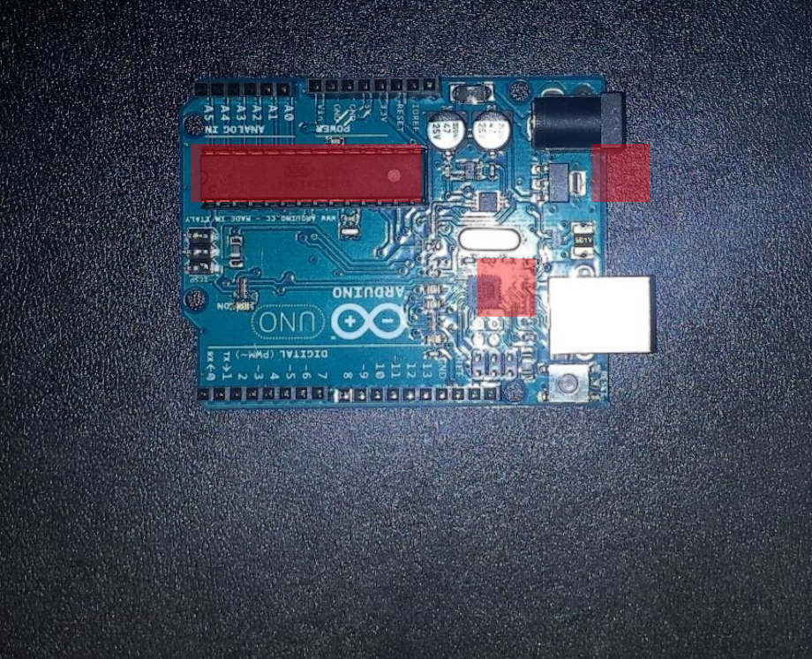
Results: Original without hsv thresholding
Invalid difference, caused by lack of HSV thresholding (Value)

Slide 18
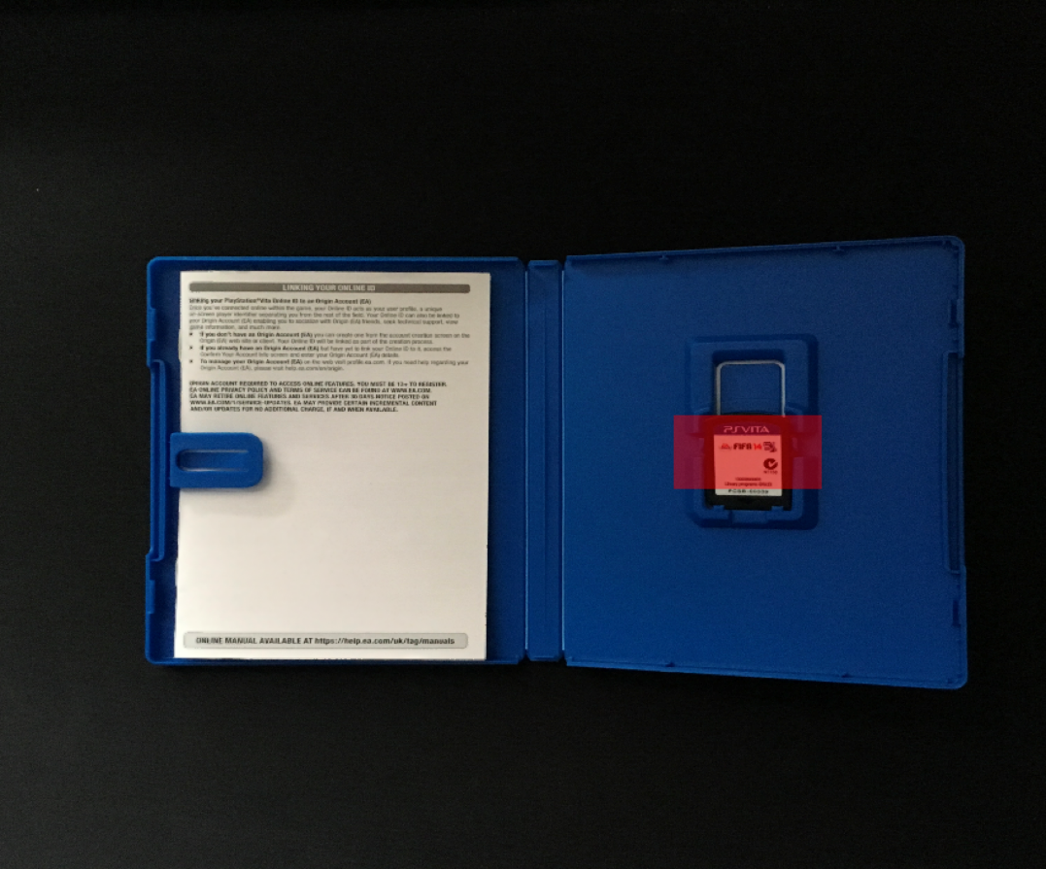
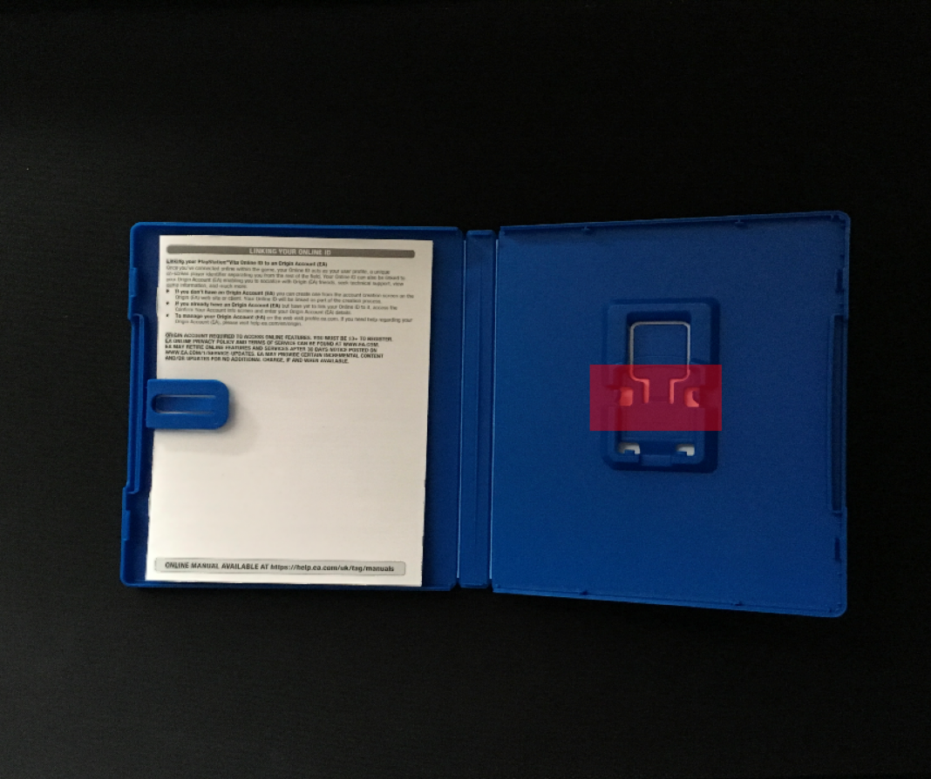
Additional Tests

Slide 19
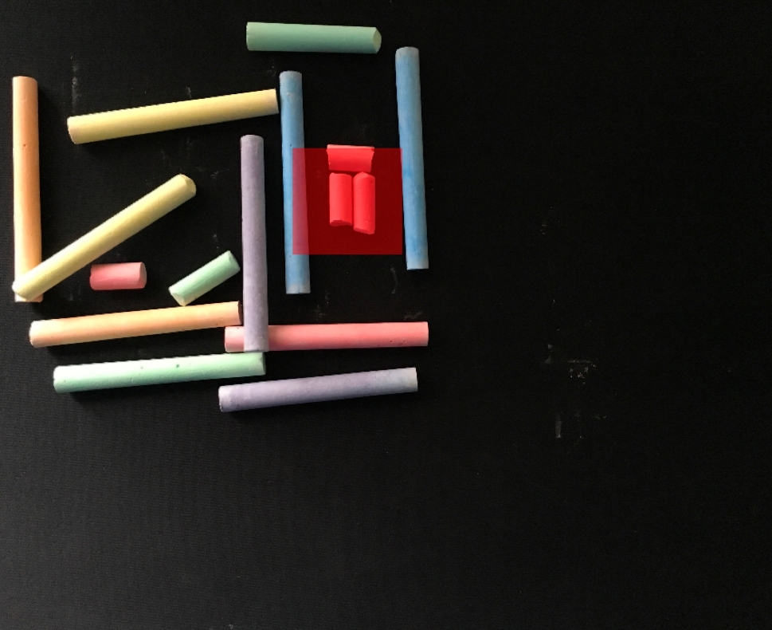
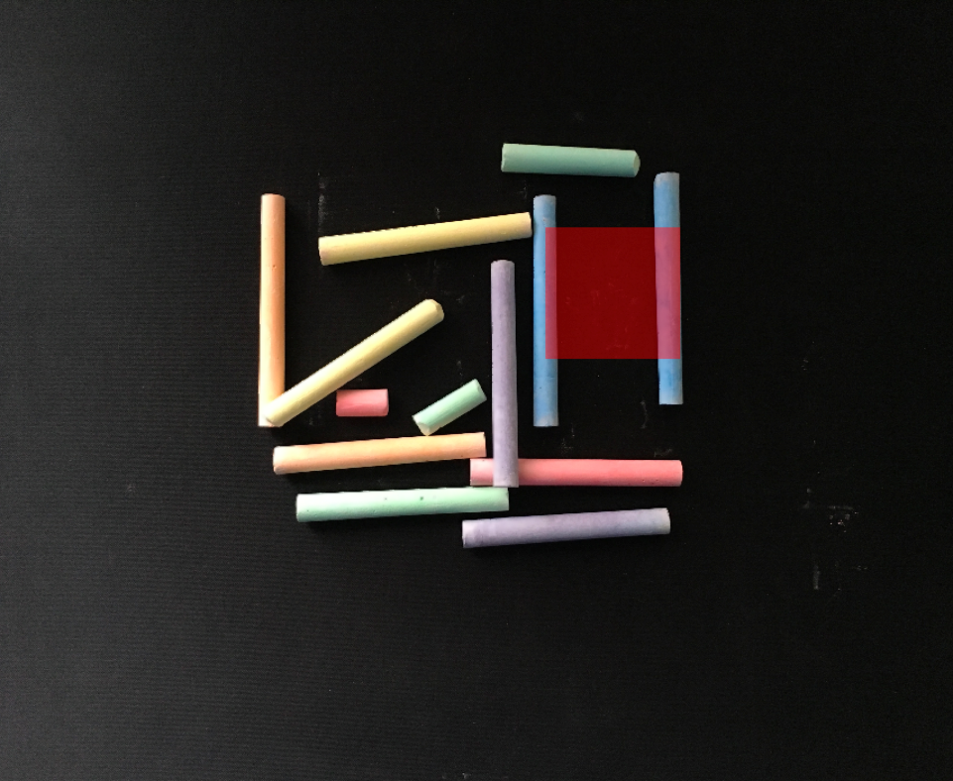
Additional tests #2

